Slide 1
Object Oriented Programming for Computer Science
Dr Michael Meredith

Slide 2

The Shape of Things to Come
Semester 1
Program using objects in C++ (classes)
Memory allocation
Cool compiler and coding stuff
Design patterns
Templates
Version control
Pros and Cons of OOP
Assignment 1
30% of the module
Semester 2
Work on medium to large-scale OOP designs and implementations
Get you thinking about your OO designs
Assignment 2
70% of the module

Slide 3
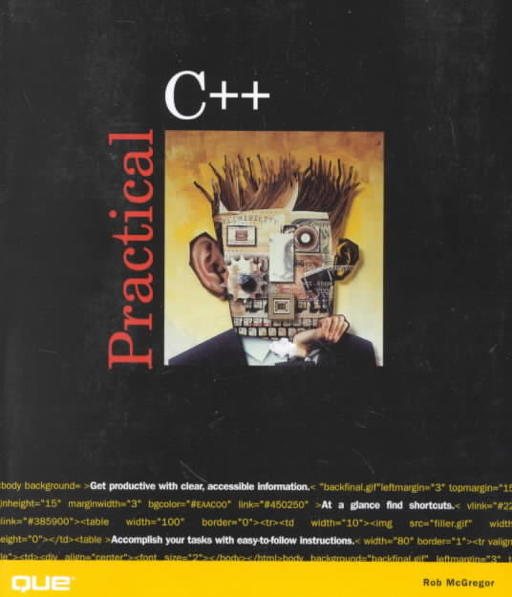
The Shape of Things to Come
Resources
Lectures & Tutorials
Take notes - we will discuss a lot of stuff as we go
General C++ Programming
Programming Principles and Practice Using C++, Bjarne Stroustrup, Addison Wesley
Object-Oriented Programming in C++
Practical C++, Rob McGregor, Que (section III onwards)
Function descriptions
The F1 key in Visual Studio (MSDN)
Extra coding resources
Lynda.com
Google / Bing / Your favourite search engine
Your time
You will need to write code to get better at it

Slide 4

OOP4CS - Recap
Recall from last year in FoP
When you write code, all you are doing is manipulating data with algorithms
Data
declaring variables
arrays
structures
Algorithms
functions / passing parameters and returning values
if-else statements
for loops
while loops
You need to think about what you are doing and create a code recipe that achieves the task - do things logically

Slide 5
OOP4CS - Recap
And here is a basic example of much of what you learnt
struct MYSTATS
{
int min, max;
double average;
};
int main()
{
int values[]={13, 43, 1, 94, 21, 5};
MYSTATS res=GetStats(values, 6);
cout << "Min: " << res.min << "\n";
cout << "Max: " << res.max << "\n";
cout << "Average: " << res.average << "\n";
return 0;
}

Slide 6
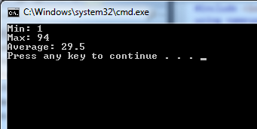
OOP4CS - Recap
MYSTATS GetStats(const int values[], const int count) {
MYSTATS res;
if (count>0) {
int sum;
sum=res.min=res.max=values[0];
for (int i=1; i<count; i++) {
sum+=values[i];
if (values[i]<res.min)
res.min=values[i];
else if (values[i]>res.max)
res.max=values[i];
}
res.average=sum/(double) count;
}
else
res.average=res.min=res.max=0;
return res; }
A note on formatting your code

Slide 7

OOP4CS - Recap
The basics from FoP will be assumed in this module
If you need to recap this information then please refer to your FoP notes and resources sooner rather than later
You also looked at standard template classes (vector), strings and pointers
We will build upon these over time, in particular pointers and template classes and a more complete recap will be done then, but it cannot hurt to review your notes on them too

Slide 8

OOP4CS - Onwards and Upwards
Think about the advantages that structures give you
Why did you use structures? For example, from your FoP group assignment:
struct Item
{
int x, y;
char symbol;
};
What might make structures (as you used them) more useful?

Slide 9

OOP4CS - Objects in C++
Objects/classes in C++ are like structures (if you squint a little)
They can contain
data
methods
Writing code using objects allows
encapsulation
better code reuse (in theory)
easier maintenance (in theory)
inheritance
polymorphism
Object Oriented Programming is a style of writing code based on objects, but is compatible with the traditional imperative style / syntax of C
C++ is just an OO extension of C
Objects don't necessarily replace structures

Slide 10
OOP4CS - First Look
Take the Item structure from earlier
Item.h
#pragma once
class Item
{
public:
Item(int x, int y, char symbol);
~Item();
int getX() const;
int getY() const;
char getSymbol() const;
void setPosition(const int x, const int y);
void move(const int dx, const int dy);
private:
int x, y;
char symbol;
};

Slide 11
OOP4CS - First Look
Take the Item structure from earlier
Item.h
#pragma once
class Item
{
public:
Item(int x, int y, char symbol);
~Item();
int getX() const;
int getY() const;
char getSymbol() const;
void setPosition(const int x, const int y);
void move(const int dx, const int dy);
private:
int x, y;
char symbol;
};
Item.cpp
#include "Item.h"
Item::Item(int x, int y, char symbol)
{
this->x=x;
this->y=y;
this->symbol=symbol;
}
Item::~Item() {}
int Item::getX() const { return x; }
int Item::getY() const { return y; }
char Item::getSymbol() const { return symbol; }
void Item::move(const int dx, const int dy) { x+=dx; y+=dy; }
void Item::setPosition(const int x, const int y) {
this->x=x;
this->y=y;
}
There is some bad practice in this example, but we'll refine this over time as we build our appreciation of objects and C++

Slide 12

OOP4CS - The Question...
So we had three lines of code for the Item structure, but using objects gives us like a million lines of code... why would you do that?

Slide 13

OOP4CS - Creating Objects in Code
Create a header (.h) and source (.cpp) file for each object
The object definition goes into the header file (.h)
This includes variables an object holds (but not local variables) and all object functions (including constructor and destructor)
The actual body of the methods go into the source file (.cpp)
We will look at exceptions to this in time (inline functions)
The "this" pointer
Refers to the objects own version of a variable

Slide 14
OOP4CS - Header Files (.h)
Class declarations take the form:
#pragma once // stops link errors when compiling
class NameOfClass // declares a new class called "NameOfClass"
{
public: // start of public method and variable declarations
NameOfClass(); // constructor - note, same name as class and no
return type
~NameOfClass(); // destructor - note, same name as class and no
return type
// add other public methods here
private: // start of private method and variable declarations
// attributes (variables) and private methods here
}; // end of the class
.h

Slide 15
OOP4CS - Source Files (.cpp)
Class declarations take the form:
#include "NameOfClass.h" // this is the file where the object
definition lives
NameOfClass::NameOfClass()
{
// do any object initialisation that needs doing here
// e.g. set up default values for variables
}
NameOfClass::~NameOfClass()
{
// do any object end-of-life stuff here
// e.g. store state to disk, clean up memory, etc
}
// other methods in the form
// returntype NameOfClass::methodName(parameters) { ... }
.cpp

Slide 16

OOP4CS - Key Points
Why objects are useful
File management of object files and their structure in C++
Sensible naming
Constructor and destructor
like functions but no return type and have the same name as the object
Getters and Setters
Functions that give indirect access to object variables
Access control (public, private) and variable scope
The "this" pointer

